Slide 1
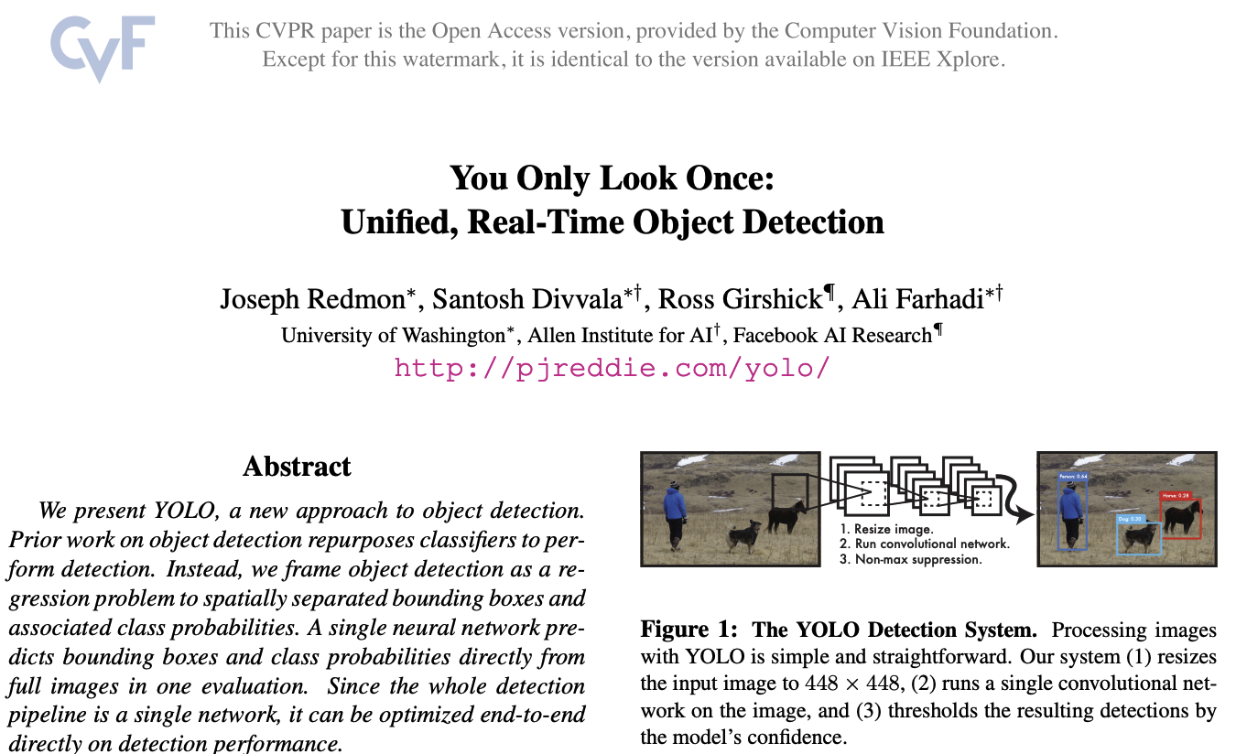
Lecture 6

Slide 2
A brief history of object detection approaches
Detection methods
  Dalal-Triggs pedestrian detector (basic concept)
  Viola-Jones detector (cascades, integral images)
  R-CNN line of detectors (CNN)
  YOLO (refinement/simplification of R-CNN)
Slides modified/borrewed from Derek Hoeim, UIUC.

Slide 3
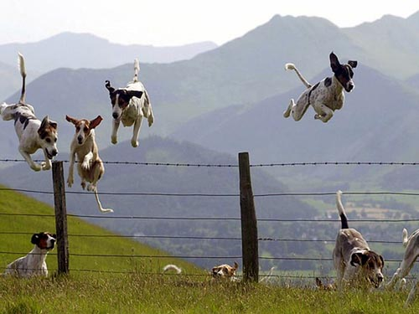
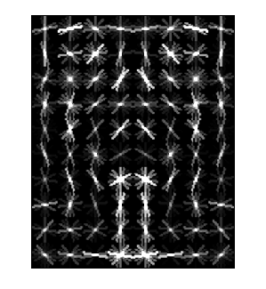
Object Category Detection
Focus on object search: “Where is it?”
Build templates that quickly differentiate object patch from background patch
Dog Model
…
Object or
Non-Object?

Slide 4
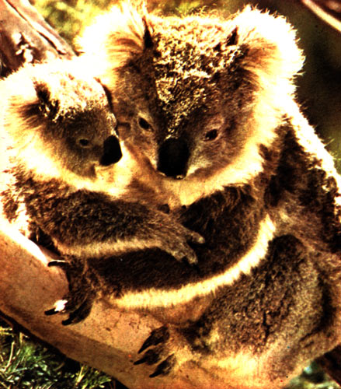
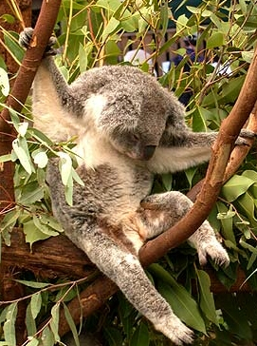
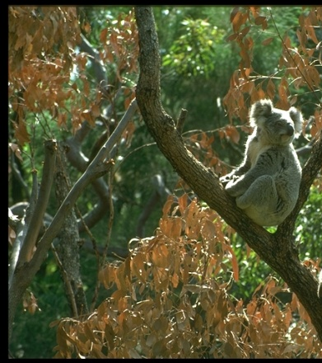

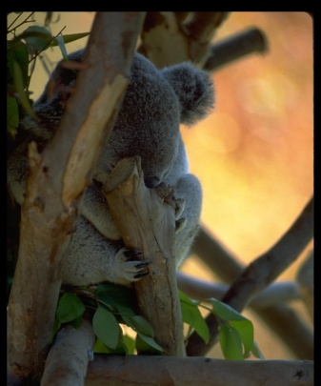
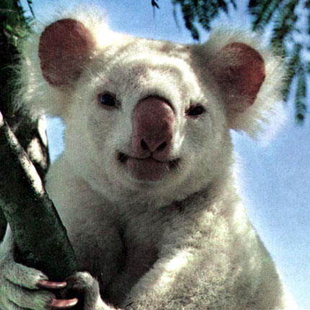
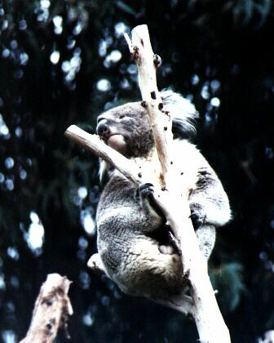
Challenges in modeling the object class
Illumination
Object pose
Clutter
Occlusions
Intra-class appearance
Viewpoint
Slide from K. Grauman, B. Leibe

Slide 5
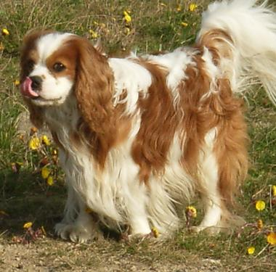
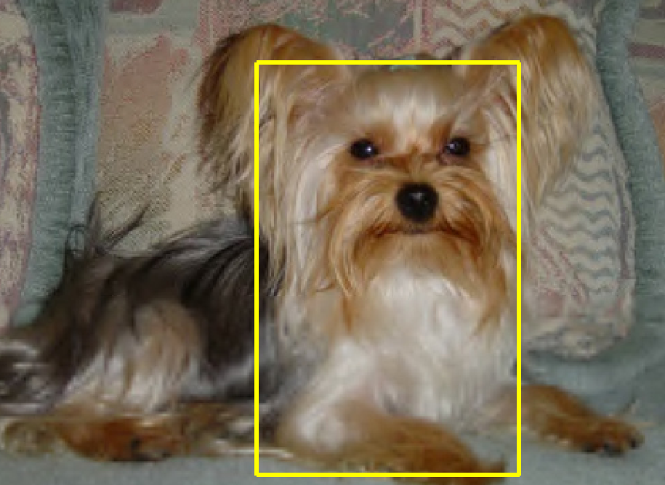
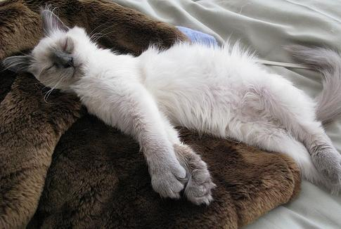
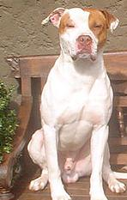
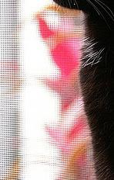

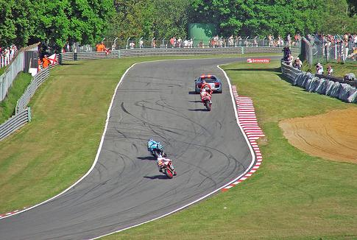

Challenges in modeling the non-object class
True Detections
Bad Localization
Confused with Similar Object
Confused with Dissimilar Objects
Misc. Background

Slide 6
General Process of Object Recognition
Specify Object Model
What are the object parameters?
Generate Hypotheses
Score Hypotheses
Resolve Detections

Slide 7
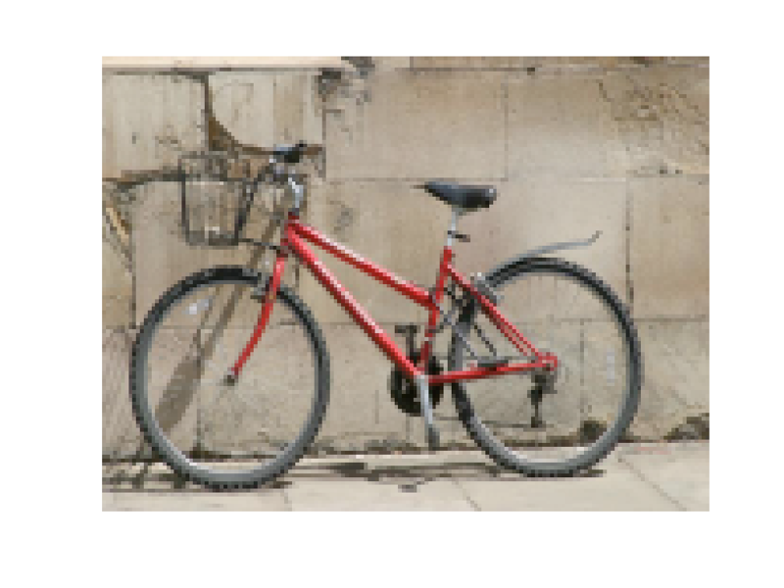
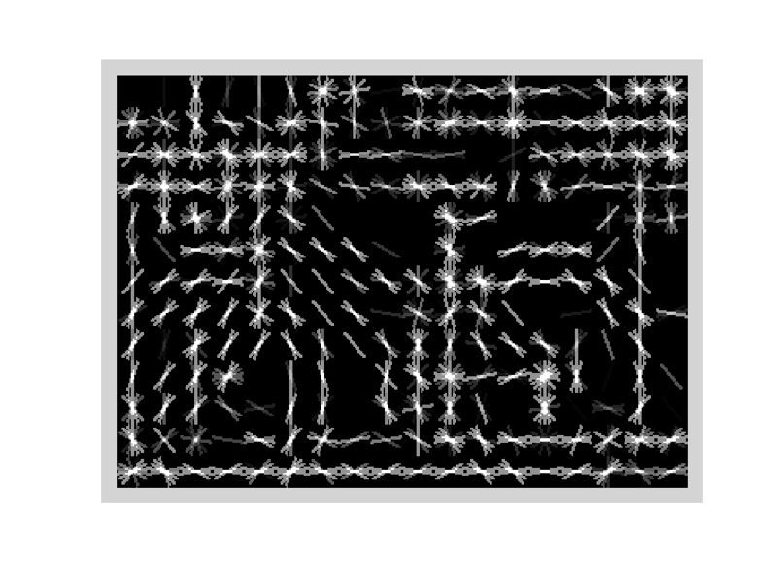
Specifying an object model
Statistical Template in Bounding Box
  Object is some (x,y,w,h) in image
  Features defined wrt bounding box coordinates
Image
Template Visualization
Images from Felzenszwalb

Slide 8
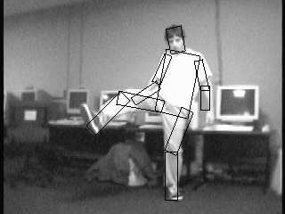
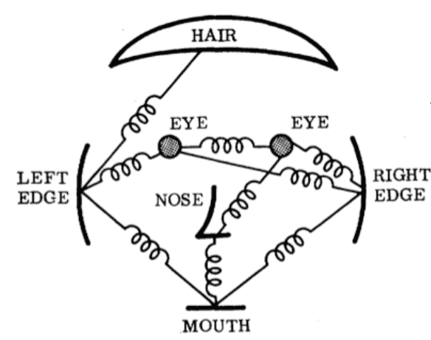
Specifying an object model
2. Articulated parts model
  Object is configuration of parts
  Each part is detectable
Images from Felzenszwalb

Slide 9
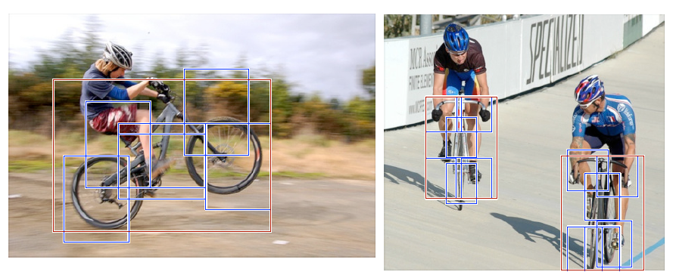
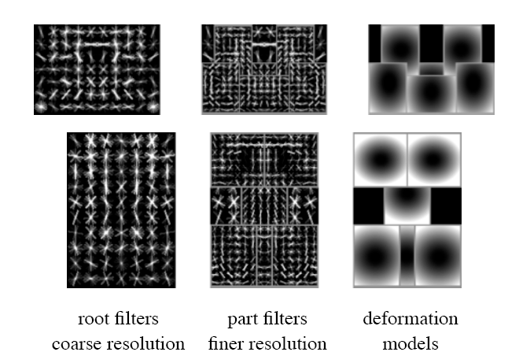
Specifying an object model
3. Hybrid template/parts model
Detections
Template Visualization
Felzenszwalb et al. 2008

Slide 10
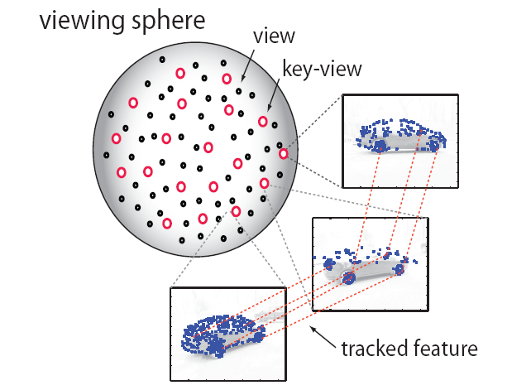
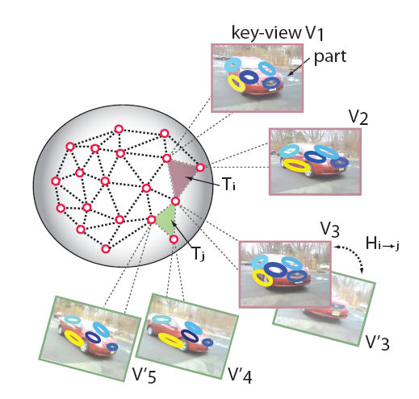
Specifying an object model
3D-ish model
Object is collection of 3D planar patches under affine transformation

Slide 11
General Process of Object Recognition
Specify Object Model
Generate Hypotheses
Propose an alignment of the model to the image
Score Hypotheses
Resolve Detections

Slide 12
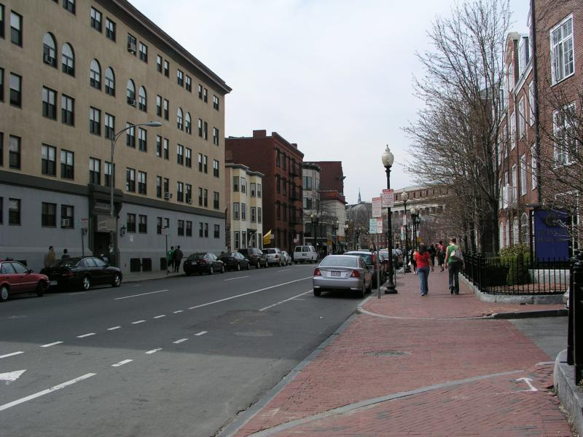
Generating hypotheses
Sliding window
  Test patch at each location and scale

Slide 13
Generating hypotheses
Sliding window
  Test patch at each location and scale

Slide 14
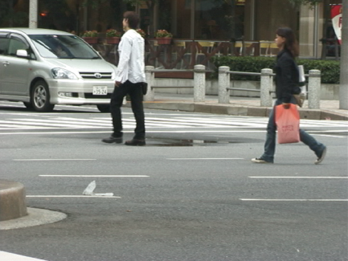
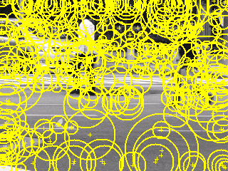
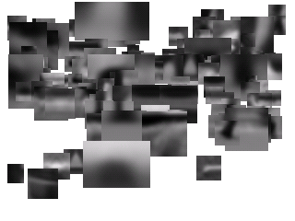
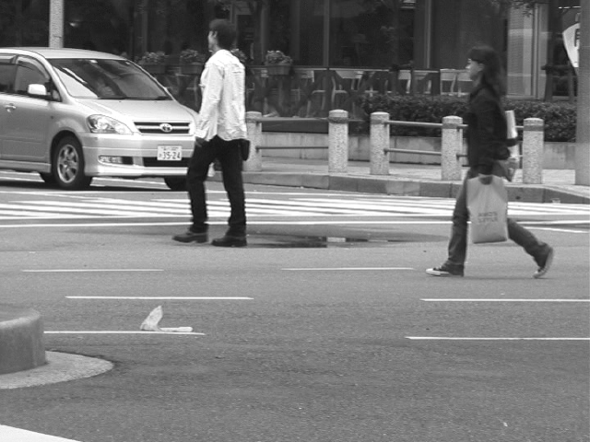
Generating hypotheses
2. Voting from patches/keypoints
Matched Codebook
Entries
Probabilistic
Voting
Interest Points
y
s
3D Voting Space
(continuous)
x
ISM model by Leibe et al.

Slide 15
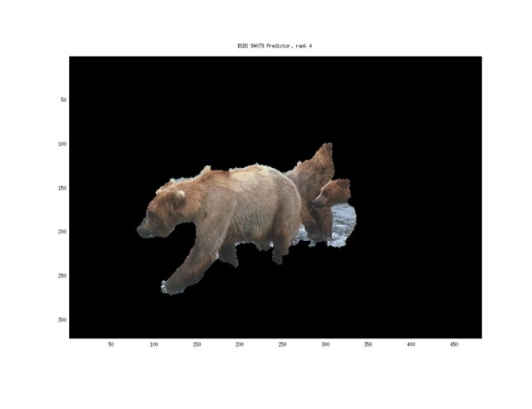
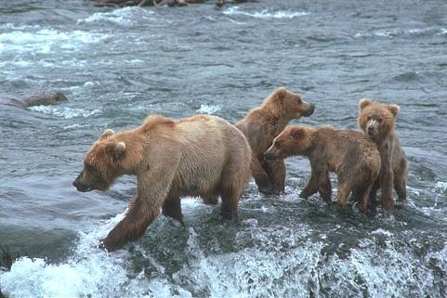
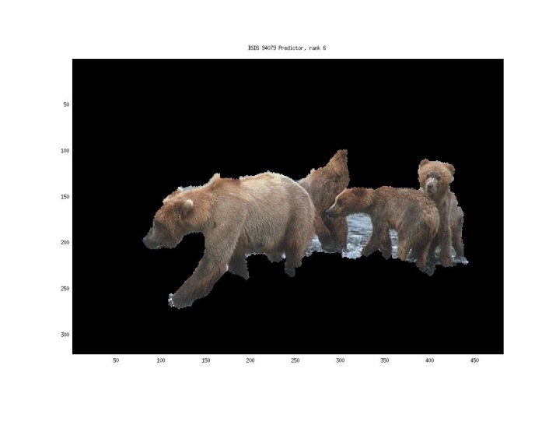
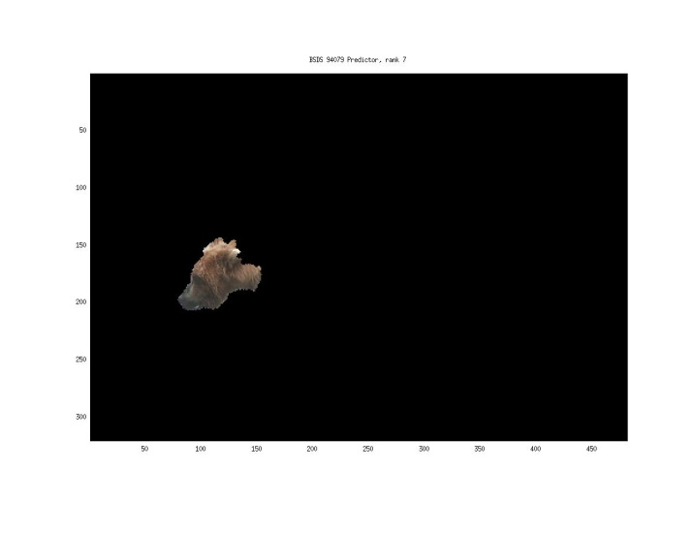
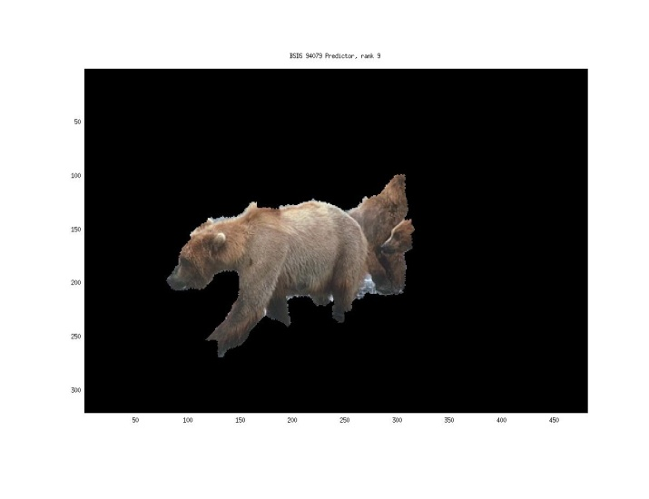
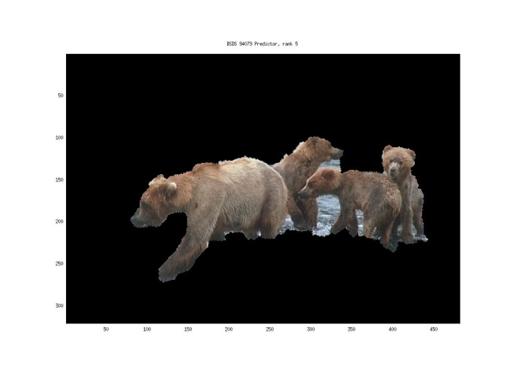
Generating hypotheses
3. Region-based proposal
Endres Hoiem 2010

Slide 16
General Process of Object Recognition
Specify Object Model
Generate Hypotheses
Score Hypotheses
Currently CNN features and classifiers
Resolve Detections

Slide 17
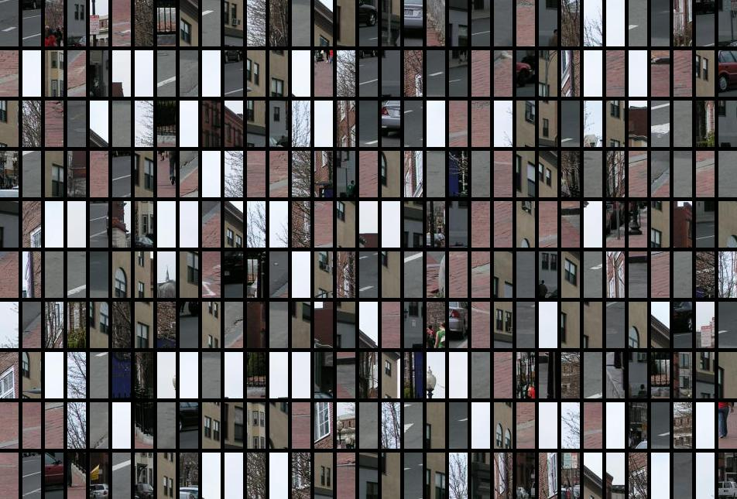
Each window is separately scored

Slide 18
General Process of Object Recognition
Specify Object Model
Generate Hypotheses
Score Hypotheses
Resolve Detections
Optionally, rescore each proposed object based on whole set

Slide 19
Resolving detection scores
Non-max suppression
Score = 0.8
Score = 0.8
Score = 0.1

Slide 20
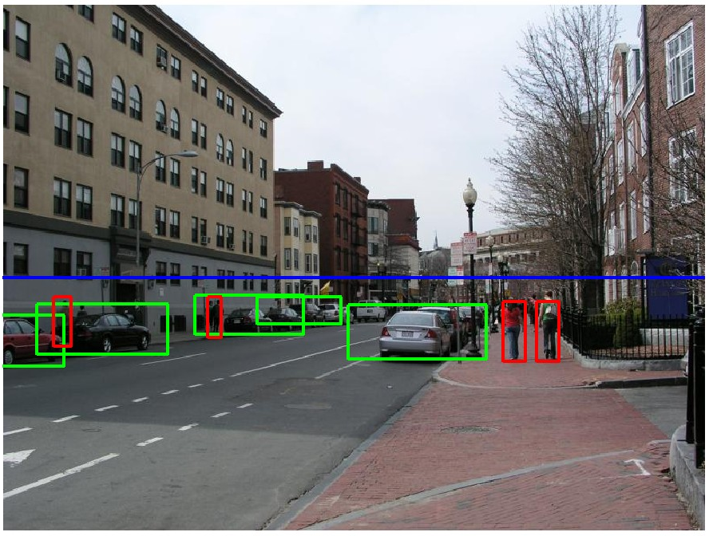
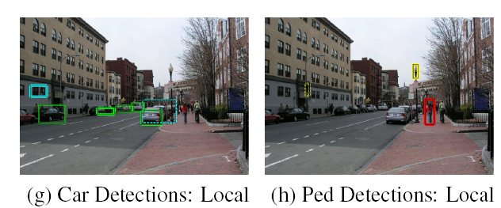
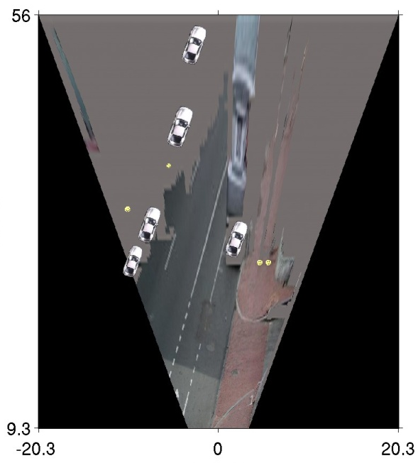
Resolving detection scores
2. Context/reasoning
meters
Hoiem et al. 2006
meters

Slide 21
General Process of Object Recognition

Slide 22
Design challenges
How to efficiently search for likely objects
  Sliding windows require searching hundreds of thousands of positions and scales
Feature design and scoring
  How should appearance be modeled? What features correspond to the object?
How to deal with different viewpoints?
  Often train different models for a few different viewpoints
Implementation details
  Window size
  Aspect ratio
  Translation/scale step size
  Non-maxima suppression
Specify Object Model
Generate Hypotheses
Score Hypotheses
Resolve Detections

Slide 23
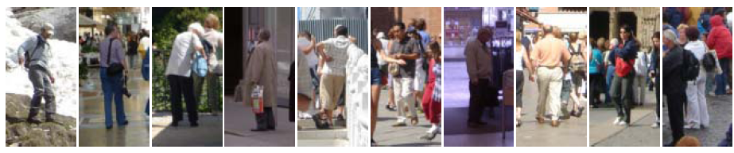
Example: Dalal-Triggs pedestrian detector
Extract fixed-sized (64x128 pixel) window at each position and scale
Compute HOG (histogram of gradient) features within each window
Score the window with a linear SVM classifier
Perform non-maxima suppression to remove overlapping detections with lower scores
Navneet Dalal and Bill Triggs, Histograms of Oriented Gradients for Human Detection, CVPR05

Slide 24

Slides by Pete Barnum
Navneet Dalal and Bill Triggs, Histograms of Oriented Gradients for Human Detection, CVPR05

Slide 25
Tested with
  RGB
  LAB
  Grayscale
Gamma Normalization and Compression
  Square root
  Log
Slightly better performance vs. grayscale
Very slightly better performance vs. no adjustment

Slide 26
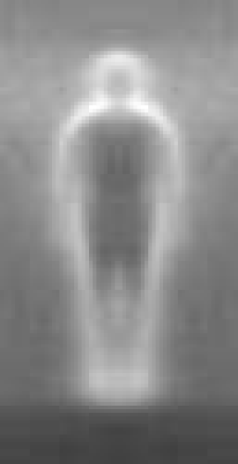

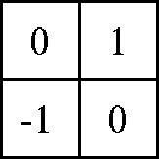

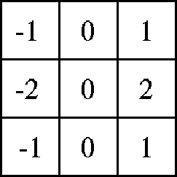

Outperforms
centered
diagonal
uncentered
cubic-corrected
Sobel
Slides by Pete Barnum
Navneet Dalal and Bill Triggs, Histograms of Oriented Gradients for Human Detection, CVPR05

Slide 27
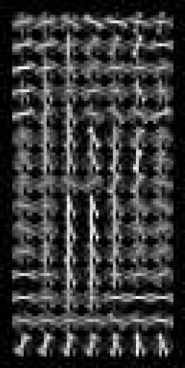
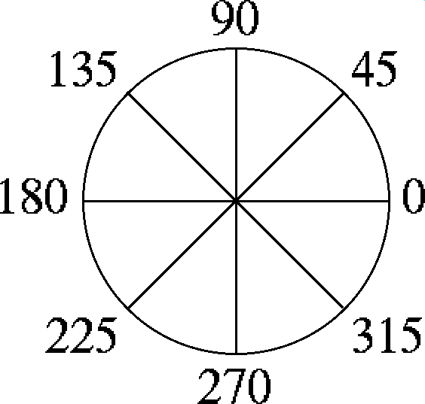

Histogram of gradient orientations
  Votes weighted by magnitude
  Bilinear interpolation between cells
Orientation: 9 bins (for unsigned angles)
Histograms in 8x8 pixel cells
Slides by Pete Barnum
Navneet Dalal and Bill Triggs, Histograms of Oriented Gradients for Human Detection, CVPR05

Slide 28
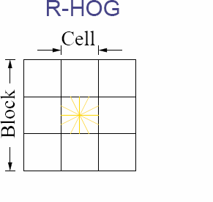
Normalize with respect to surrounding cells
Slides by Pete Barnum
Navneet Dalal and Bill Triggs, Histograms of Oriented Gradients for Human Detection, CVPR05

Slide 29
# orientations
# features = 15 x 7 x 9 x 4 = 3780
X=
# cells
# normalizations by neighboring cells
Slides by Pete Barnum
Navneet Dalal and Bill Triggs, Histograms of Oriented Gradients for Human Detection, CVPR05

Slide 30
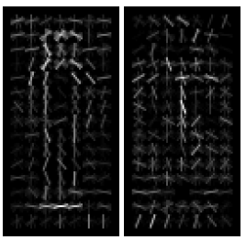
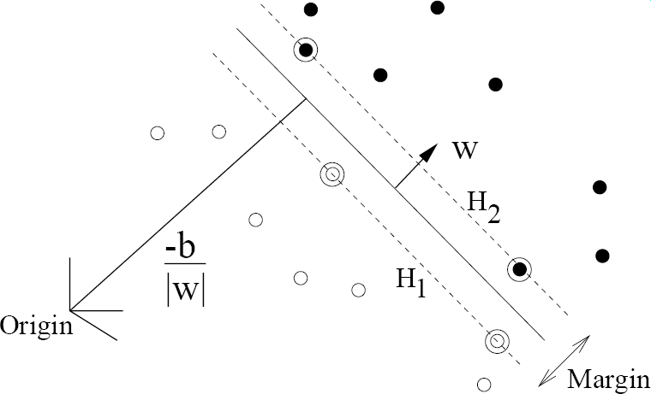
pos w
neg w
Slides by Pete Barnum
Navneet Dalal and Bill Triggs, Histograms of Oriented Gradients for Human Detection, CVPR05

Slide 31
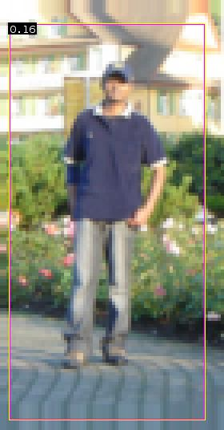


pedestrian
Slides by Pete Barnum
Navneet Dalal and Bill Triggs, Histograms of Oriented Gradients for Human Detection, CVPR05

Slide 32
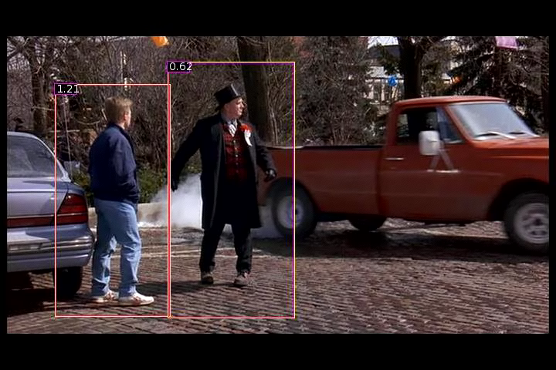
Detection examples

Slide 33
Viola-Jones sliding window detector
Fast detection through two mechanisms
Quickly eliminate unlikely windows
Use features that are fast to compute
Viola and Jones. Rapid Object Detection using a Boosted Cascade of Simple Features (2001).

Slide 34
Cascade for Fast Detection
Choose threshold for low false negative rate
Fast classifiers early in cascade
Slow classifiers later, but most examples don’t get there
Stage 1
H₁(x) > t₁?
Yes
Stage 2
H₂(x) > t₂?
Stage N
H_{N}(x) > t_{N}?
Yes
…
Pass
No
No
No
Examples
Reject
Reject
Reject

Slide 35
Features that are fast to compute
“Haar-like features”
  Differences of sums of intensity
  Thousands, computed at various positions and scales within detection window
-1
+1
Two-rectangle features
Three-rectangle features
Etc.

Slide 36
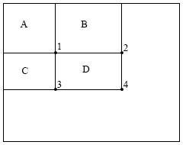
Integral Images
ii = cumsum(cumsum(im, 1), 2)
x, y
ii(x,y) = Sum of the values in the grey region
How to compute B-A?
How to compute A+D-B-C?

Slide 37

Feature selection with Adaboost
Create a large pool of features (180K)
Select features that are discriminative and work well together
  “Weak learner” = feature + threshold + parity
  Choose weak learner that minimizes error on the weighted training set
  Reweight

Slide 38

Adaboost

Slide 39

Top 2 selected features

Slide 40


Viola Jones Results
Speed = 15 FPS (in 2001)
MIT + CMU face dataset

Slide 41
Pop Quiz!
Sliding window detectors work
  very well for faces
  fairly well for cars and pedestrians
  badly for cats and dogs
Why are some classes easier than others?

Slide 42

Object Detection Evaluation
Datasets
  PASCAL VOC (2005-2012): 20 classes, ~20,000 images
  MS COCO (2014-?): 60 classes, ~300,000 images
Evaluation
  Output: for each class, predict bounding boxes (x1, y1, x2, y2) with confidences
  Metric:
    True detection: >= 0.5 Intersection over Union (IoU), not a duplicate
    Precision: $\frac{\# true detections}{\# detections}$ Recall: $\frac{\# true detections}{\# positive examples}$
    AP: area under the interpolated curve
IoU = 0.45
Intersecting Area

Slide 43
HOG Template
Statistical Template Matching
HOG: Dalal-Triggs 2005

Slide 44
Deformable Parts Model (v1-v5)
HOG Template
Better Models of Complex Categories
HOG: Dalal-Triggs 2005 DPM: Felzenszwalb et al. 2008-2012

Slide 45
R-CNN
Regionlets
Deformable Parts Model (v1-v5)
HOG Template
Key Advance: Learn effective features from massive amounts of labeled data and
adapt to new tasks with less data
Better Features
HOG: Dalal-Triggs 2005 DPM: Felzenszwalb et al. 2008-2012 Regionlets: Wang et al. 2013 R-CNN: Girshick et al. 2014

Slide 46
R-CNN (Girshick et al. CVPR 2014)
Replace sliding windows with “selective search” region proposals (Uijilings et al. IJCV 2013)
Extract rectangles around regions and resize to 227x227
Extract features with fine-tuned CNN (that was initialized with network trained on ImageNet before training)
Classify last layer of network features with SVM
http://arxiv.org/pdf/1311.2524.pdf

Slide 47
Fine-tuning example: ImageNet->VOC
Train full network on ImageNet 1000-class classification
Replace classification layer with output layer for VOC (e.g. confidences for 20 classes)
Train on VOC pos/neg examples with low initial learning rate (1/10th what is used for new network)
Notes
This usually works well if the “big data” task and target task are similar (object classification vs detection)
  0.45 AP without fine-tuning → 0.54 AP with fine tuning; training only on VOC does much worse
Not necessary if target task is also very big

Slide 48
Sliding window vs. region proposals
Sliding window
Region proposals
Comprehensive search over position, scale (sometimes aspect, though expensive)
Typically 100K candidates
Simple
Speed boost through convolution often possible
Repeatable
Even with many candidates, may not be a good fit to object
Search over regions guided by image contours/patterns with varying aspect/size
Typically 2-10K candidates
Random (not repeatable)
Requires a preprocess (currently 1-5s)
Often requires resizing patch to fit fixed size
More likely to provide candidates with very good object fit

Slide 49
Mistakes are often reasonable
Confident Mistakes
Bicycle: AP = 0.73
R-CNN results

Slide 50
Mistakes are often reasonable
Horse: AP = 0.69
Confident Mistakes
R-CNN results

Slide 51
Fast R-CNN – Girshick 2015
Compute CNN features for image once
Pool into 7x7 spatial bins for each region proposal, output class scores and regressed bboxes
100x speed up of R-CNN (0.02 – 0.1 FPS → 0.5-20 FPS) with similar accuracy

Slide 52
Faster R-CNN – Ren et al. 2016
Convolutional features used for generating proposals and scoring
  Generate proposals with “objectness” scores and refined bboxes for each of k “anchors”
  Score proposals in same way as Fast R-CNN
Similar accuracy to Fast R-CNN with 10x speedup

Slide 53
Faster R-CNN slightly better accuracy than Fast R-CNN
More data improves results considerably

Slide 54
YOLO – Redmon et al. 2016
CNN produces 4096 features for 7x7 grid on image (fully conv.)
Each cell produces a score for each object and 2 bboxes w/ conf
Non-max suppression
7x speedup over Faster RCNN (45-155 FPS vs. 7-18 FPS)
Some loss of accuracy due to lower recall, poor localization

Slide 55
Yolo v2 – Redmon et al. 2017
Batch normalization
Pre-train on higher resolution ImageNet
Use and improve anchor box idea from Faster RCNN
Train at multiple resolutions
Very good accuracy, very fast
https://youtu.be/VOC3huqHrss

Slide 56


Slide 57
Questions!
"Since I haven't worked with neural networks, I don't really understand how YOLO uses a single convolutional neural network to predict the bounding box and category probabilities of an image. Does the number of convolutional layers affect the speed of image detection?”
The CNN in Yolo learns to output:
(c,x,y,w,h)1, (c,x,y,w,h)2, p(A), p(B), p(c)

Slide 58
Can you walk through an example of non-maximal suppression, also some current models avoid this step entirely (by folding it into the model architecture itself i.e. learned) do you know why this wasn't possible/successful for the initial YOLO paper?”
"Regarding NMS, If I understand correctly, if two objects of the same class are very close to each other, and their bounding boxes have significant overlap, NMS might incorrectly suppress a valid detection. Does this mean the NMS-based object detection has its intrinsic drawback and future ideal object detection methods should eliminate the use of NMS?"

Slide 59
"What does the program use for initial bounding boxes to approximate objects before proceeding with the rest of the process? Color similarity? Contrast? Is it based on the 'segment anything' processes?"

Slide 60
"To what extent does the minute details of the NN used matter? Most of the papers we've read talk about their NN structure - but what meaningful information does the architecture matter? Are the layers chosen arbitrarily (apart from any mathematical consequences, such as a 2x2 pooling function reducing each dimension by half), and does it matter?"

Slide 61
"How do methods such as YOLO and SSD tackle the issue of class imbalance during their training phase? Given the various methods to address class imbalance in object detection, such as sampling strategies and loss function modifications, what are the challenges and potential drawbacks of implementing these solutions in real-world applications, especially regarding computational efficiency and model scalability?"

Slide 62
I know they take input image of size 448 * 448, but how do they resize it? what if someone used a picture with very extreme aspect ratios such as 50*1000?

Slide 63
How does the YOLOv1 model evolved into the current SOTA YOLOv8, particularly in terms of data augmentation techniques, its backbone architecture, and performance?"
https://deci.ai/blog/history-yolo-object-detection-models-from-yolov1-yolov8/

Slide 64


Slide 65

What do you need to make a camera from scratch?

Slide 66
Mapping between image and world coordinates
  Pinhole camera model
  Projective geometry
    Vanishing points and lines
  Projection matrix

Slide 67

Camera and World Geometry
How tall is this woman?
How high is the camera?
What is the camera rotation?
Which ball is closer?

Slide 68
Image formation
Let’s design a camera
  Idea 1: put a piece of film in front of an object
  Do we get a reasonable image?
Slide source: Seitz

Slide 69
Pinhole camera
Idea 2: add a barrier to block off most of the rays
  This reduces blurring
  The opening known as the aperture
Slide source: Seitz
Notes:
Q: How does this transform the image? A: It gets inverted

Slide 70

Pinhole camera
f
c
f = focal length
c = center of the camera
Figure from Forsyth

Slide 71


Camera obscura: the pre-camera
Known during classical period in China and Greece (e.g. Mo-Ti, China, 470BC to 390BC)
Illustration of Camera Obscura
Freestanding camera obscura at UNC Chapel Hill
Photo by Seth Ilys

Slide 72

Camera Obscura used for Tracing
Lens Based Camera Obscura, 1568

Slide 73


First Photograph
Oldest surviving photograph
  Took 8 hours on pewter plate
Photograph of the first photograph
Joseph Niepce, 1826
Stored at UT Austin
Niepce later teamed up with Daguerre, who eventually created Daguerrotypes

Slide 74

Non pinhole cameras?!

Slide 75
Dimensionality Reduction Machine (3D to 2D)
3D world
2D image
Figures © Stephen E. Palmer, 2002

Slide 76

Projection can be tricky…
Slide source: Seitz

Slide 77

Projection can be tricky…
Slide source: Seitz

Slide 78

Vanishing points and lines
Parallel lines in the world intersect in the image at a “vanishing point”
Notes:
Go to board, sketch out various properties of vanishing points/lines

Slide 79
Vanishing points and lines
Vanishing Point
Vanishing Point
o
o
Vanishing Line
Notes:
Go to board, sketch out various properties of vanishing points/lines
Parallel lines intersect at a point
The intersection of red lines and blue lines form a parallelogram
Sets of parallel lines on the same plane form a vanishing line
Sets of parallel planes form a vanishing line
Not all lines that intersect are parallel

Slide 80

Vanishing points and lines
Vertical vanishing
point
(at infinity)
Vanishing
line
Vanishing
point
Vanishing
point
Slide from Efros, Photo from Criminisi

Slide 81

Vanishing points

Slide 82
Projection: world coordinates→image coordinates
.
Optical Center (u₀, v₀)
.
.
f
Z
Y
.
v
Camera Center (t_{x}, t_{y}, t_{z})
u

Slide 83

Another common diagram of pinhole projection.
This time we are going to look at the coordinate systems in the pinhole camera model.

Slide 84
“Normalized Camera”
Pinhole at (0,0,0), point P at (X,Y,Z)
Virtual film at Z = 1 plane.
Point X,Y,Z is imaged at intersection of:
  Line from (0,0,0) to (X,Y,Z), and
  the Z = 1 plane
Intersection point (x,y), has coordinates
  (X/Z, Y/Z, 1)
This is called the “normalized camera model”
What happens when focal length is not 1?
Camera Center of Projection

Slide 85
(X,Y,Z)
Pinhole,
(Center of projection), at (0,0,0)
f
Z-axis
Image plane

Slide 86

…but the cow is not a sphere
We don’t just want to know where, mathematically, the point ends up on the image plane… we want to know the pixel coordinates of the point.
Why might this be hard?!

Slide 87
Intrinsic Camera Parameters
The pixels may be rectangular:
x = αX/Z
Y = βY/Z
CCD sensor array

Slide 88
Intrinsic Camera Parameters
Chip not centered, or 0,0 may not be center of the chip.
x = αX/Z + x₀
Y = βY/Z + y₀
CCD sensor array

Slide 89

Intrinsic Camera Parameters
cheap CMOS chip
cheap lens
image
cheap
glue
cheap camera
x = αX/Z – α cot(θ) Y/Z + x₀
y = β/sin(θ) Y/Z + y₀
Ugly relationship between (X,Y,Z) and (x,y).

Slide 90
Homogeneous Coordinates
Represent 2d point using 3 numbers, instead of the usual 2 numbers.
Mapping 2d→ 2d homogeneous:
  (x,y) → (x,y,1)
  (x,y) → (sx, sy, s)
Mapping 2d homogeneous to 2d
  (a,b,w) → (a/w, b/w)
The coordinates of a 3D point (X,Y,Z) *already is* the 2D (but homogeneous) coordinates of its projection.
Will make some things simpler and linear.

Slide 91
Why?!
x = αX/Z – α cot(θ) Y/Z + x₀
y = β/sin(θ) Y/Z + y₀

Slide 92
Homogenous Coordinates!
Equation of a line on the plane?
Equation of a plane through the origin in 3D?

Slide 93


Given enough examples of 3D points and their 2D projections, we can solve for the 5 intrinsic parameters…
Example calibration object…

Slide 94
Practical Linear Algebra 1:
Given many examples of the equation at the right, solve for the matrix of values fx, fy, s, x0, y0
How can we solve for this?

Slide 95
… and all this assumes that we know X,Y,Z
Given enough examples of 3D points and their 2D projections, we can solve for the 5 intrinsic parameters…
Exactly Known!
(0,0,0)

Slide 96
More commonly, we can put a collection of points (usually in a grid) in the world with known relative position, but with unknown position relative to the camera.
Then we need to solve for the intrinsic calibration parameters, and the extrinsic parameters (the unknown relative position of the grid).
How do we represent the unknown relative position of the grid?

Slide 97

The grid defines its own coordinate system
That coordinate system has a
Euclidean transformation that relates its coordinates to the camera coordinates… that is, there is some R, T such that:
X
Z
Y
With enough example points, could we solve for R,T?

Slide 98
An aside…Representation of Rotation with a Rotation Matrix
Rotation matrix R has two properties:
Property 1:
    R is orthonormal, i.e.
In other words,
Property 2: Determinant of R is 1.
Therefore, although the following matrix is orthonormal,
it is not a rotation matrix because its determinant is -1.
this is a reflection matrix

Slide 99
Representation of Rotation -- Euler Angles
Euler angles
  pitch: rotation about x axis :
  yaw: rotation about y axis:
  roll: rotation about z axis:
Z
Y
X

Slide 100
Putting it all together…
+
P is a 4X3 matrix, that defines projection of points (used in graphics). P has 11 degrees of freedom, (the scale of the matrix doesn’t matter). 5 intrinsic parameters, 3 rotation, 3 translation

Slide 101
Given many examples of:
  World points (X,Y,Z), and
  Their image points (x,y)
Solve for P.
Then
Rotation + intrinsic, all mixed up.
translation

Slide 102

Then take the QR decomposition of this part of the matrix to get the rotation and the intrinsic parameters.
(from mathworld).

Slide 104
Other common trick, use many planes, then you have to solve for multiple different R,T, one for each plane…
Counting:
For each grid, we have 3 unknowns (translation),
3 unknowns (rotation).
+ 5 extra unknowns defining the intrinsic calibration.
Method. For a collection of planes, calculate the homography between the image and the real world plane.

Slide 105


Slide 106


Slide 107


Slide 108


Slide 109


Slide 110

Corners..

Slide 111


Slide 112


Slide 113


What is left?
Barrel and Pincushion Distortion
wideangle
tele

Slide 114
What other calibration is there?

Slide 115

Models of Radial Distortion
distance from center

Slide 116

More distortion.

Slide 117


Distortion Corrected…

Slide 118
Applications?

Slide 119
Cheap applications
Can you use this? If you know the 3D coordinates of a virtual point, then you can draw it on your image…
Often hard to know the 3D coordinate of a point; but there are some (profitable) special cases…

Slide 120

Applications
First-down line
courtesy of Sportvision

Slide 121

Applications
Virtual advertising
courtesy of Princeton Video Image

Slide 122
Recap
Three main concepts:
1) Projection,
2) Homogeneous coordinates
3) Camera calibration matrix

Slide 124
Another Special Case, the world is a plane.
Projection from the world to the image:
Ignore z-coordinate (it is 0 anyway), drop the 3rd column of the P matrix, then you get a mapping between the plane and the image which is an arbitrary 3 x 3 matrix. This is called a “homography”.
0
Irrelevant

Slide 125
Homography: (x’,y’,1) ~ H (x,y,1)
Not a constraint. Unlike the fundamental matrix, tells you exactly where the point goes.
Point (x,y) in one frame corresponds to point (x’,y’) in the other frame. If we need to think about multiple points, we may put subscripts on them.
Being careful about the homogenous coordinate, we write:

Slide 126
Homography is a “simple” example of a 3D to 2D transformation
It is also the “most complicated” linear 2D to 2D transformation.
What other 2D → 2D transformations are there?

Slide 127
Homography is most general, encompasses other transformations
Views of a plane from different viewpoints, any view of a scene from the same viewpoint.
Projective
8 dof
Affine
6 dof
Images of a “far away” object under any rotation
Similarity
4 dof
Camera looking at an assembly line w/ zoom.
Euclidean
3 dof
Camera looking at an assembly line.

Slide 128
Invariants…
Concurrency, collinearity, order of contact (intersection, tangency, inflection, etc.), cross ratio
Projective
8 dof
Parallellism, ratio of areas, ratio of lengths on parallel lines (e.g midpoints).
Affine
6 dof
Similarity
4 dof
Ratios of any edge lengths, angles.
Euclidean
3 dof
Absolute lengths, areas.

Slide 129






Image registration
Determining the 2d transformation that brings one image into alignment (registers it) with another.

Slide 130





Image Warping
What kind of warps are these?
Notes:
Interpolation is basic tool that we have to deal with it. There are many interpolation
methods -- for example, nearest neighbor, bilinear, and bicubic.
Next is the image warping. This is the example of image warping. The left image
is the original image. And we apply the motion parameters here. After warping
or transforming, we will get this as the result.
The motion parameters here is of the projective model. Therefore, we can see that
the resulting image contain many effects together like the rotation, translation,
zooming in here, shrinking around here, chirping and keystoning.

Slide 131
How to solve for these mappings?
Given:
Solve for:

Slide 132
Unwrapping a matrix.
Write out the lines of this matrix equation.
And remember which variables are unknown.

Slide 133
Unwrapping a matrix.

Slide 134
Looks like another matrix equation:

Slide 135
Looks like another matrix equation:
Data from different points

Slide 136
Why does this suck?
Maybe you have error in finding corresponding points, and want to use many many corresponding points. Then your number of unknowns keeps growing…
Is there a better way?
What is x’?

Slide 137
The game of “finding the linear constraint…”
x’ = wx’ / w
Non-linear
Linear (in a,b,c,g,h)

Slide 139
And just add two more rows for each corresponding point

Slide 140
Ax=b
Matlab: x = A\b
Then make your homography matrix by rearranging x into a 3 x 3 matrix
Size of A? b?

Slide 141



Slide 142




H₁₂
H₂₃
(H₁₂)⁻¹
H₃₄
(H₃₄H₂₃H₁₂)
(H₃₄H₂₃H₁₂)⁻¹= ((H₁₂)⁻¹(H₂₃)⁻¹(H₃₄)⁻¹)
Chaining, inverses, and pre-computation can all be done on the matrices…

Slide 143


Slide 144
More than Geometry: image processing
The above gave different ways of transforming the coordinates of one image into the coordinates of another.
Graphics question.
  Given one image, the homography H, make the second image.
    (why would you want to do this? One application is image tweening…).
  Process:
    Take pixel (x,y) of image 1, and put its color at pixel H(x,y,1) in new image. Repeat.
  Problems?

Slide 145
Backward Transformation
Because of the above, some techniques estimate the parameters of the “backwards” transformation, H⁻¹:
  From the destination image to the source image
Remember, you don’t have to work hard to find the backwards transformation. It’s just the matrix inverse.

Slide 146
Mapping Pixel Values - Going Backwards
p = H⁻¹(p’)
p’
“Source” image, I_{s}
“Destination” image, I_{d}
I_{d}(p’) = I_{s}(H⁻¹(p’))
Intensity at destination pixel p’ = the intensity at the source pixel H⁻¹(p’)

Slide 147

If you project backward from a real pixel, you also won’t land exactly on a pixel??!!?
(but there is a good way of making up a value)
H⁻¹(p’)
Pixel centers…

Slide 148
If you project backward from a real pixel, you also won’t land exactly on a pixel??!!?
(but there is a good way of making up a value)

Slide 149
Use linear interpolation along the top and bottom horizontal lines to determine I_{A} and I_{B}:
I_{A} = (1 – f)•I(x_{i}, y_{j}) + f•I(x_{i+1}, y_{j})
I_{B} = (1 – f)•I(x_{i}, y_{j+1})+ f•I(x_{i+1}, y_{j+1})
Use linear interpolation along the vertical line between I_{A} and I_{B} to determine I(x,y):
I(x,y) = (1 – g)•zA + g•zB
Or,
I(x,y) =
(1 – f)•(1 – g)•I(x_{i}, y_{j}) + f•(1 – g)•I(x_{i+1}, y_{j}) +
(1 – f)• g •I(x_{i}, y_{j+1}) + f• g •I(x_{i+1}, y_{j+1})

Slide 150


Beyond geometry…

